Slide 2
Technology All Around Us
T
There are lots of different types of technology that we can see in the world around us.
Take a look at these photos.
What can you see?
Have you used any of these things before?
Have you seen other people using these things?
What other types of technology do you use at school or at home?

Slide 3
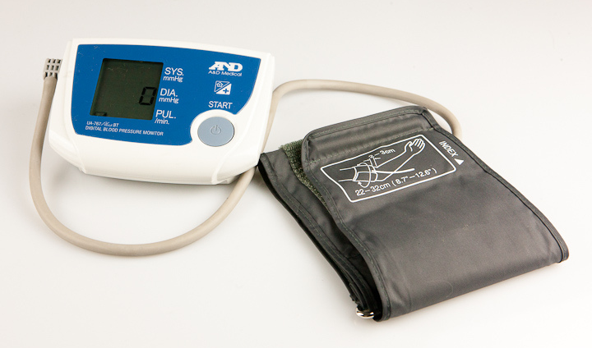
blood pressure monitor
“Blood pressure monitor” by Tunstall is licensed under CC BY 2.0

Slide 4
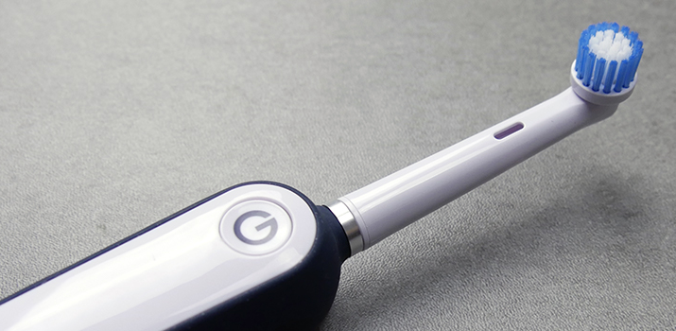
electric toothbrush
“Goby Electric Toothbrush” by Electric Teeth is licensed under CC BY 2.0

Slide 5
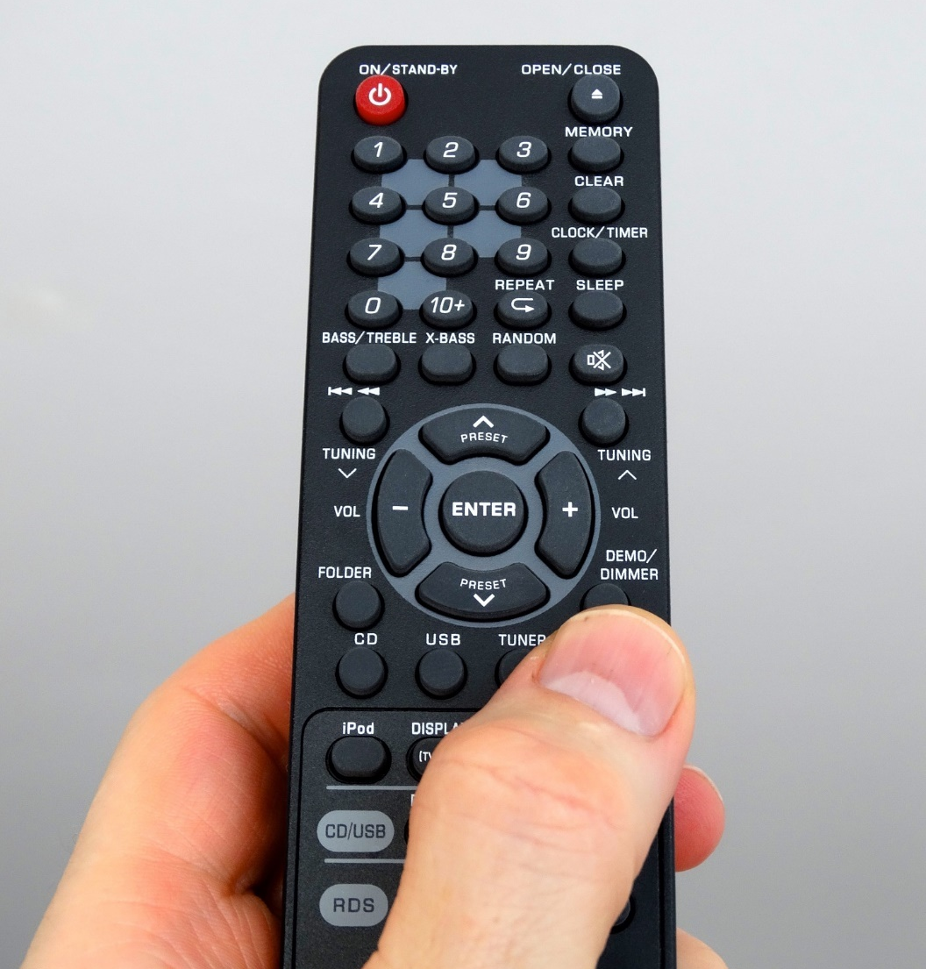
remote control

Slide 6
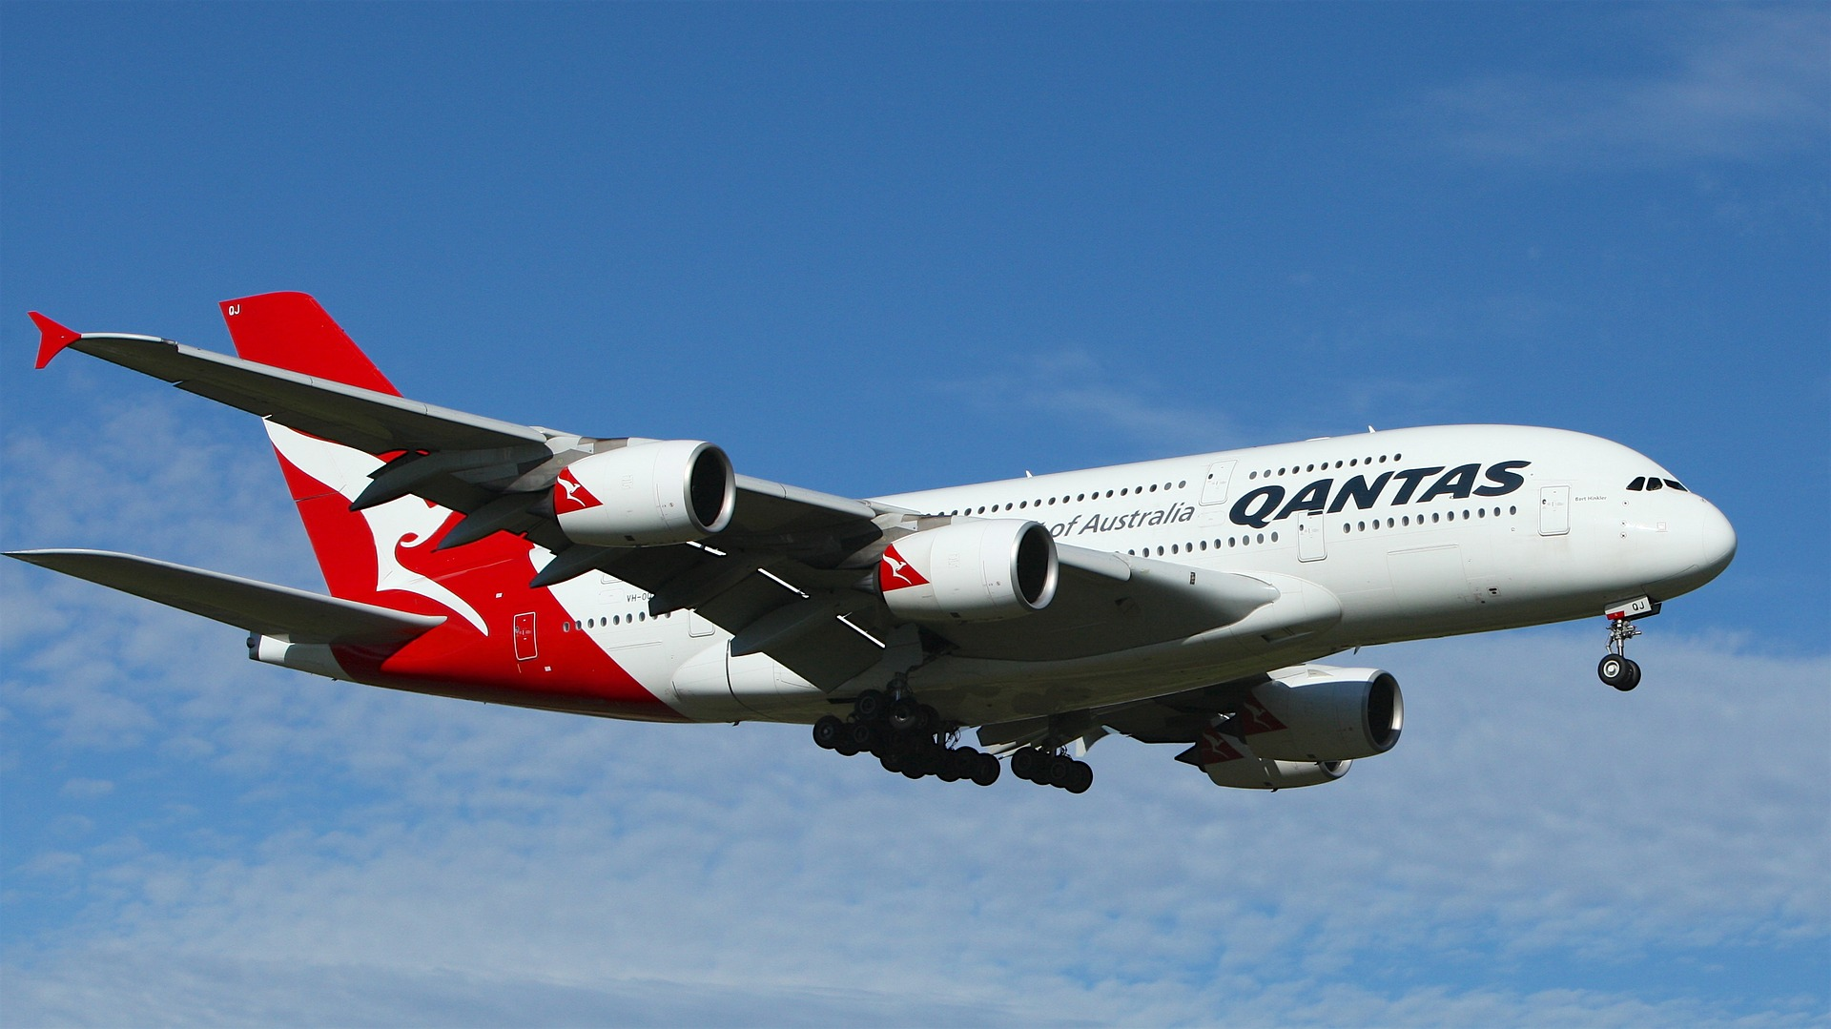
aeroplane

Slide 7
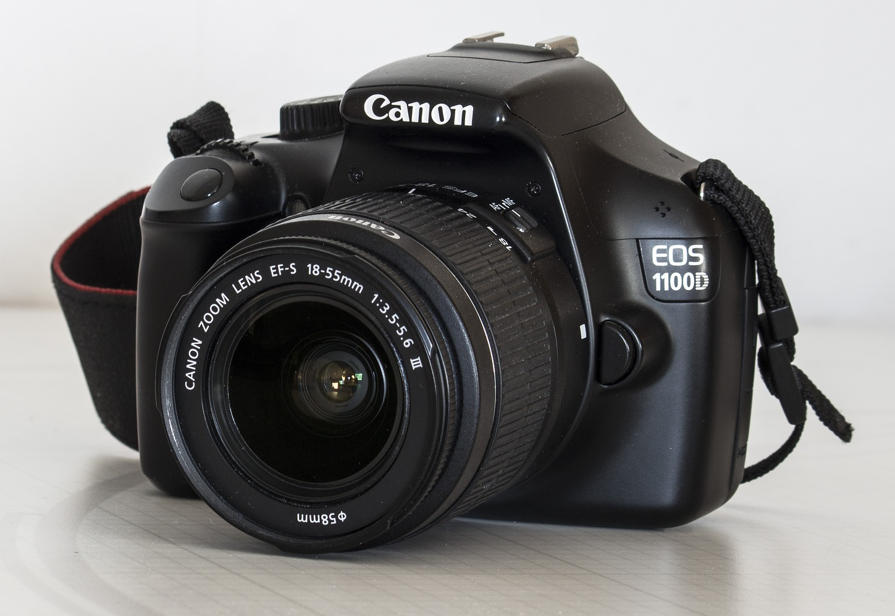
digital camera

Slide 8
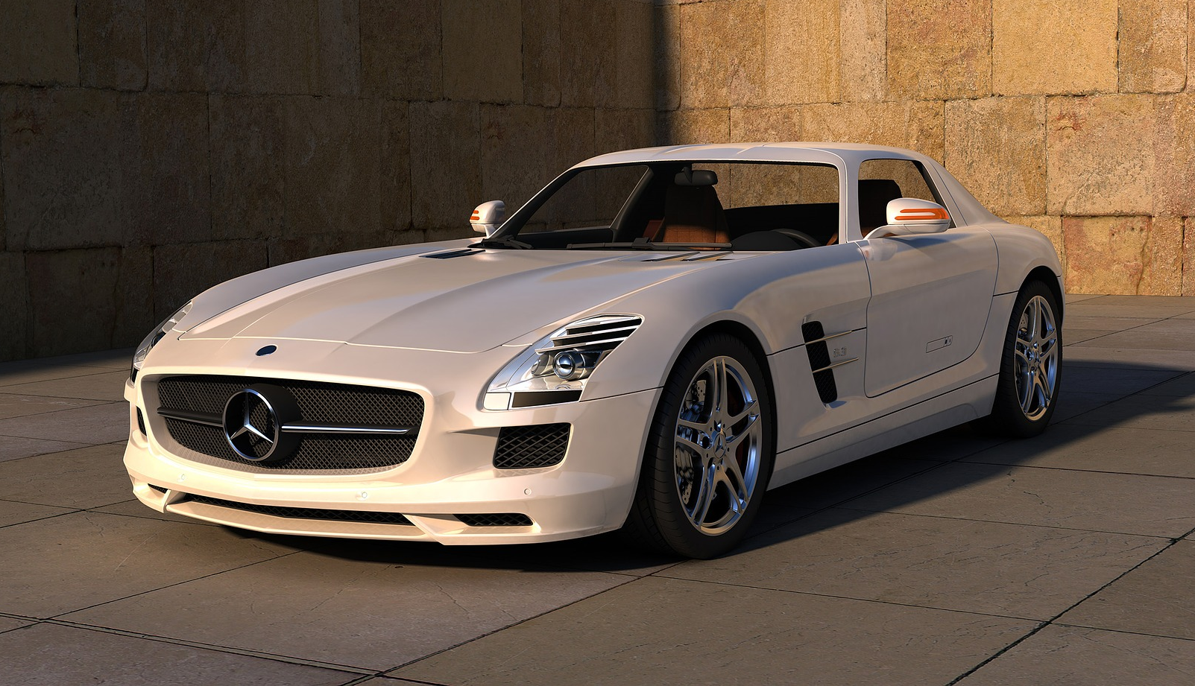
car

Slide 9
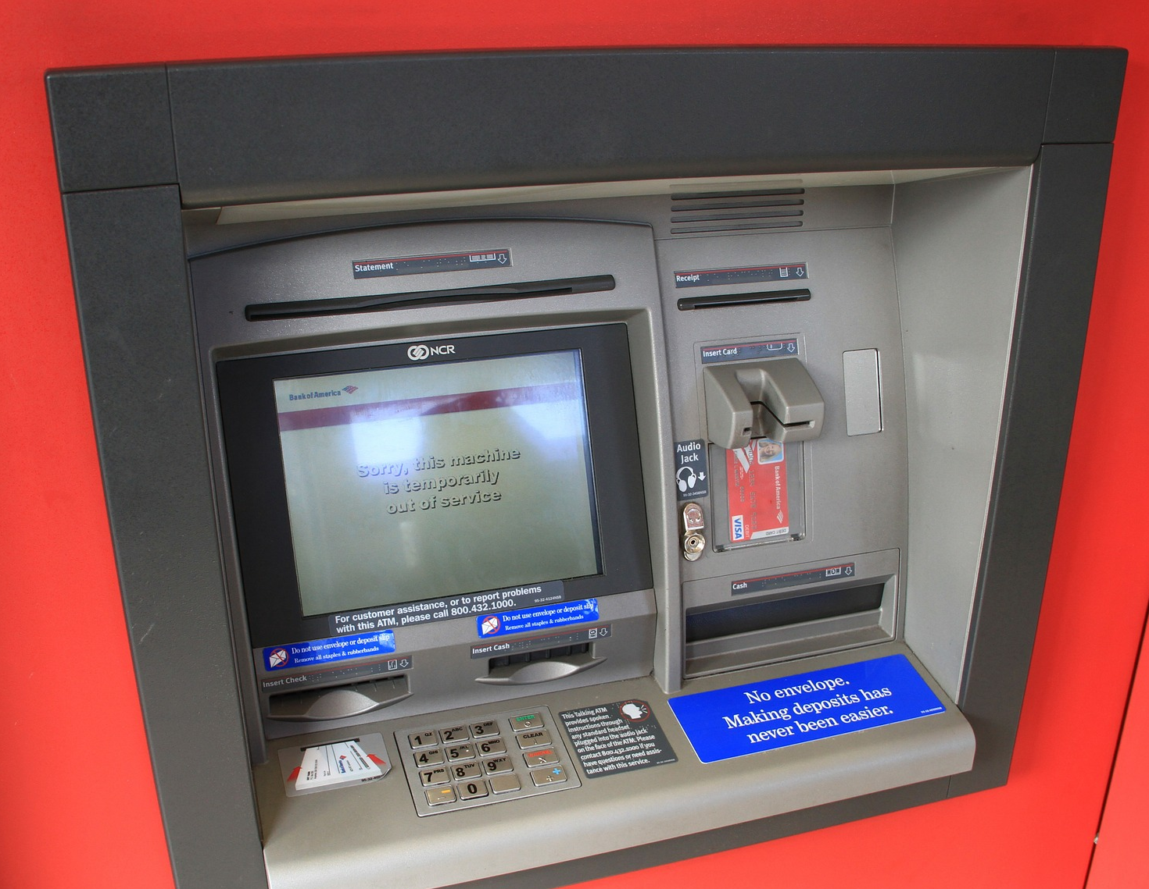
cash machine

Slide 10
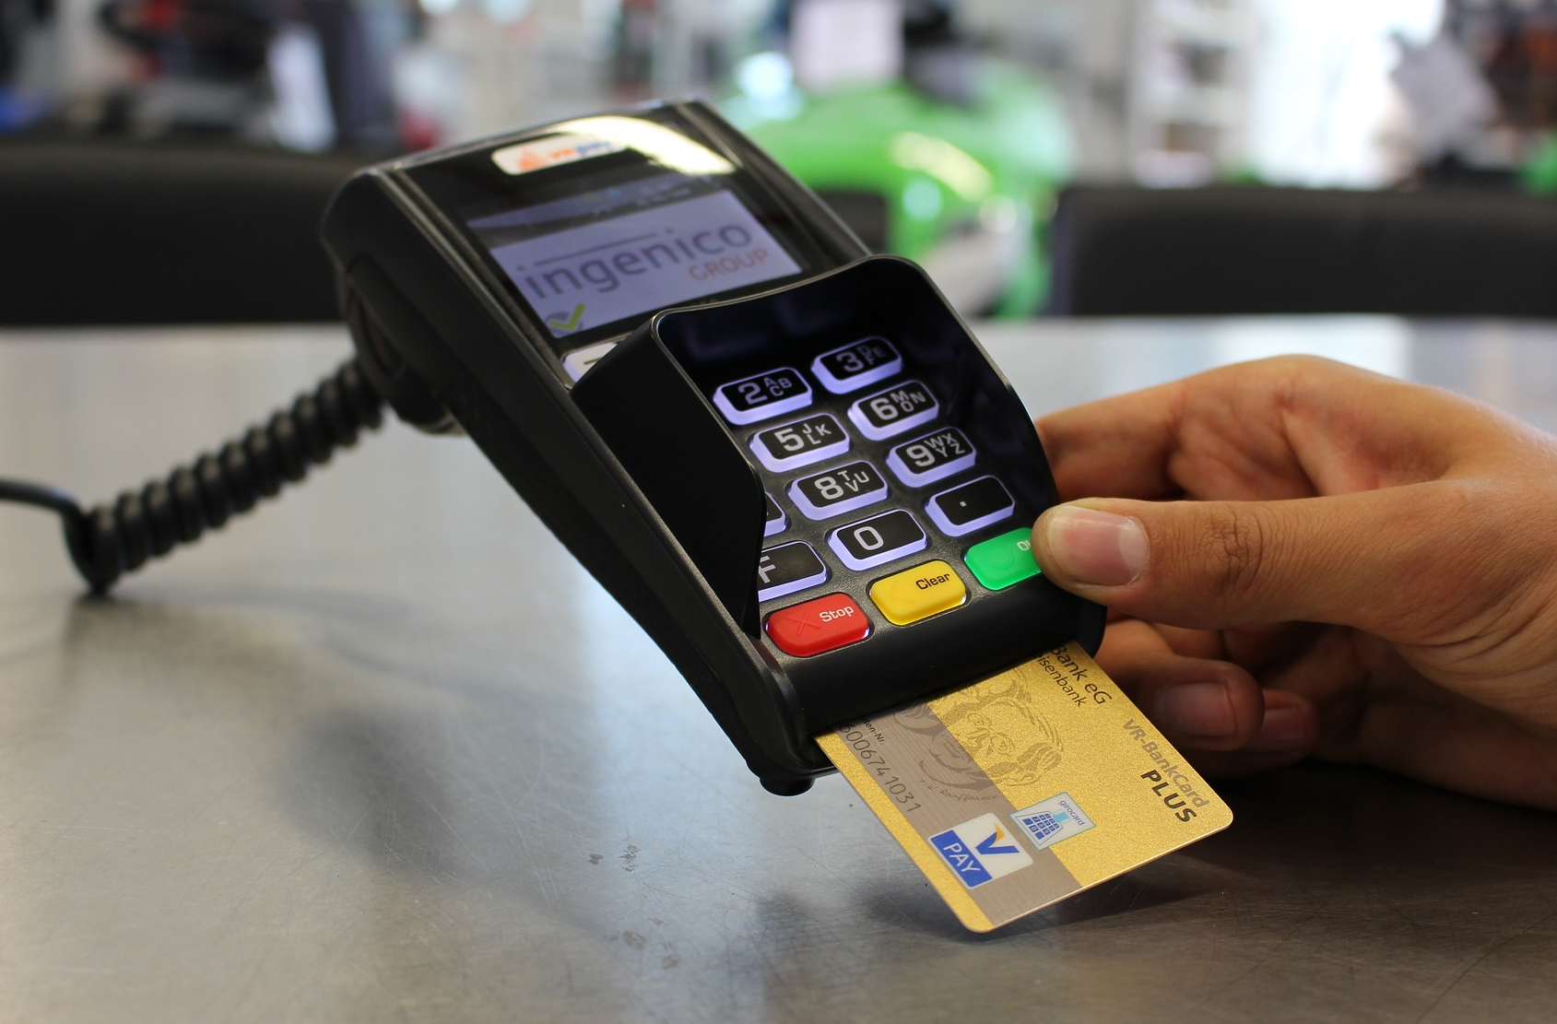
credit card reader

Slide 11
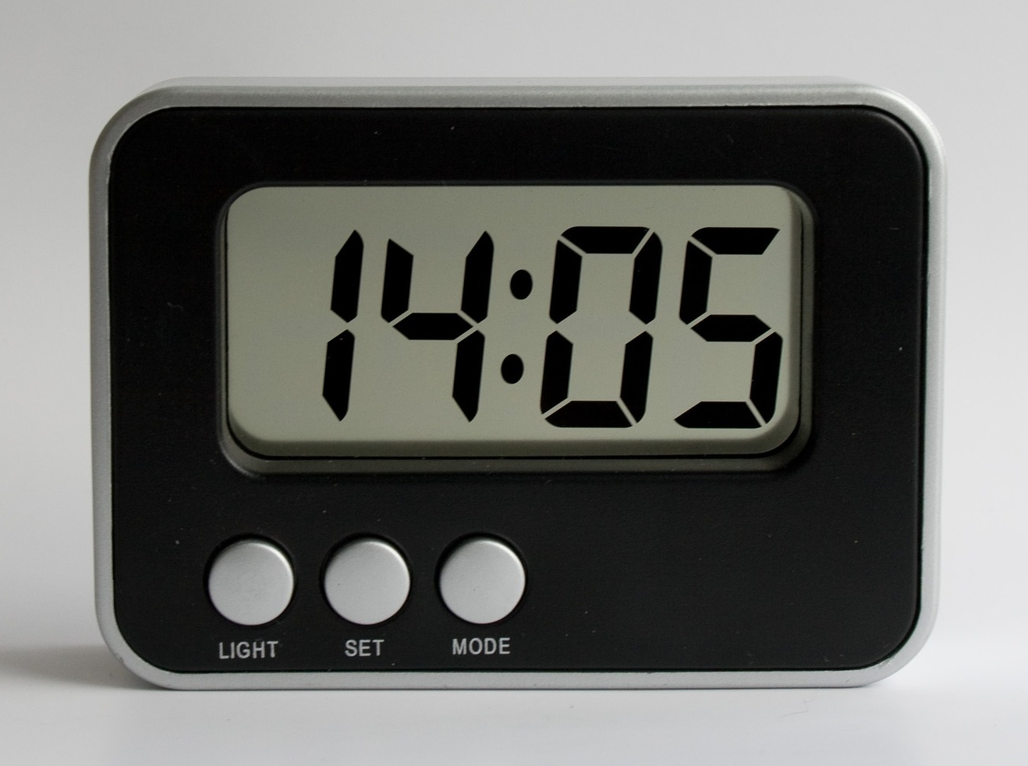
digital clock

Slide 12
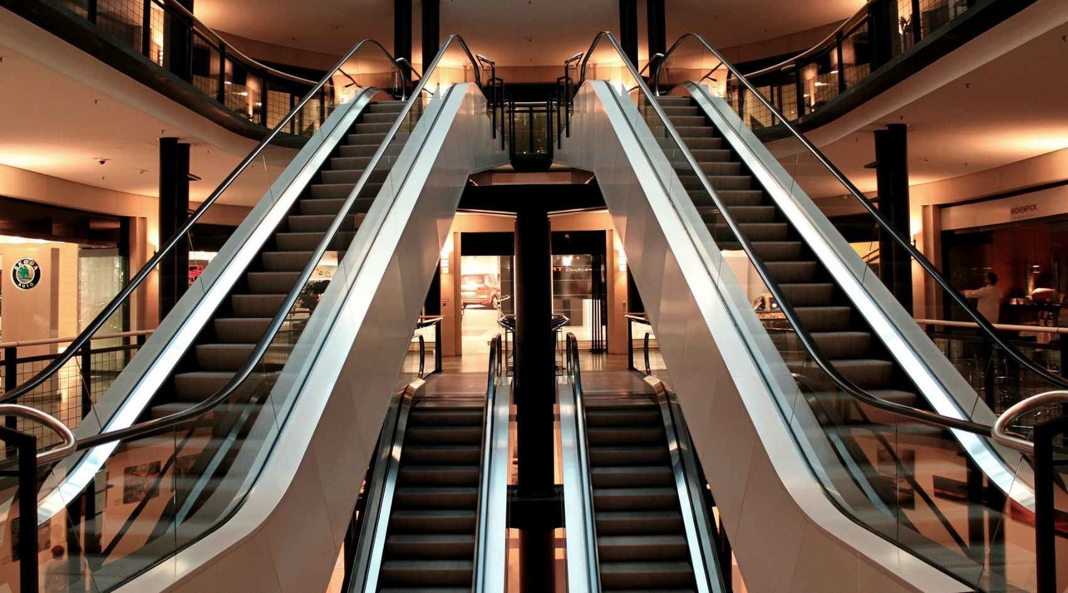
escalator

Slide 13
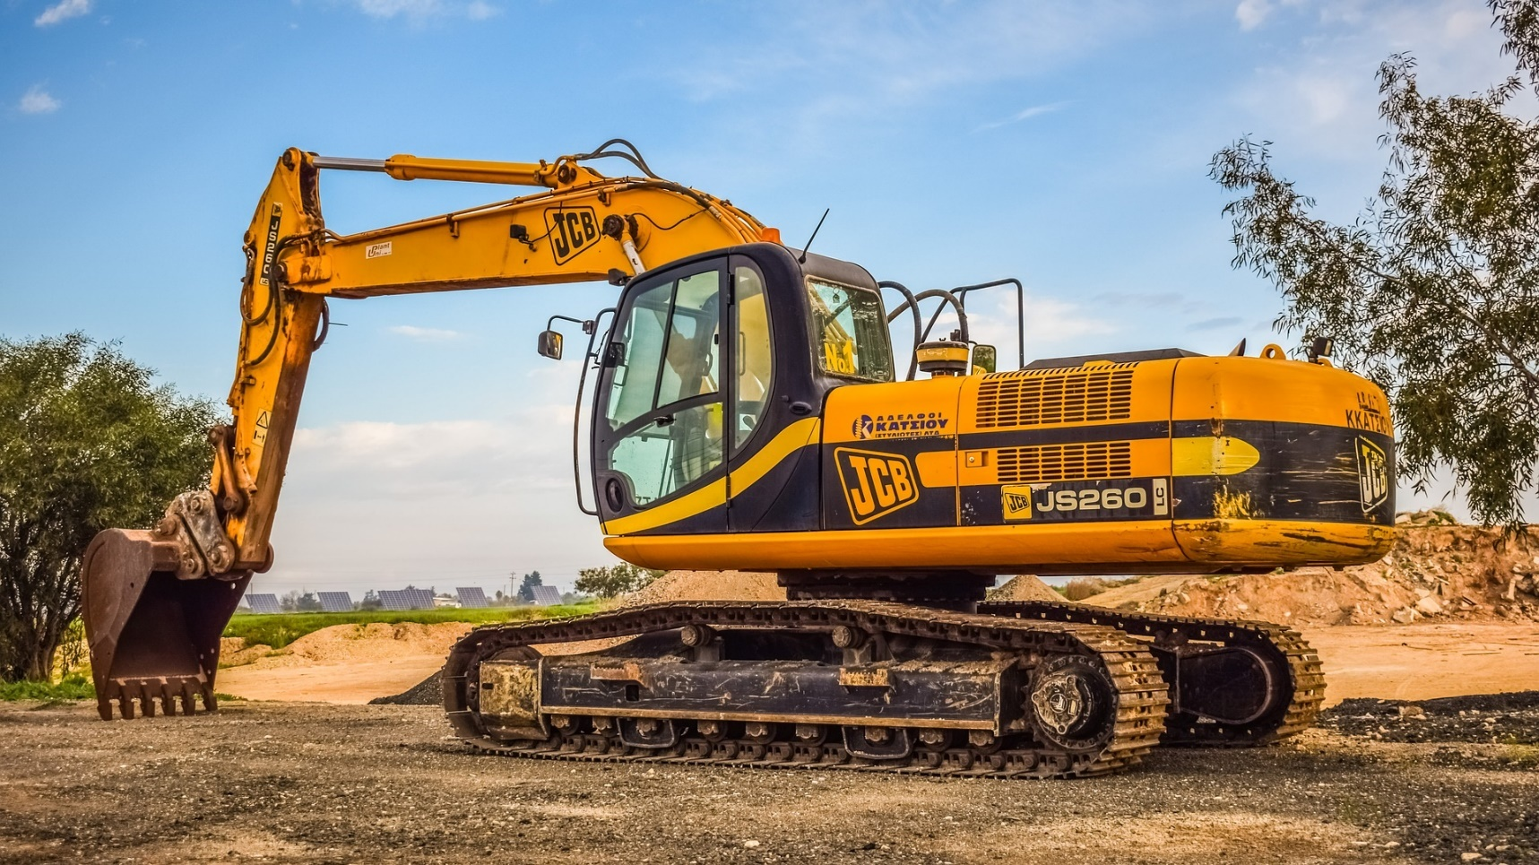
excavator

Slide 14
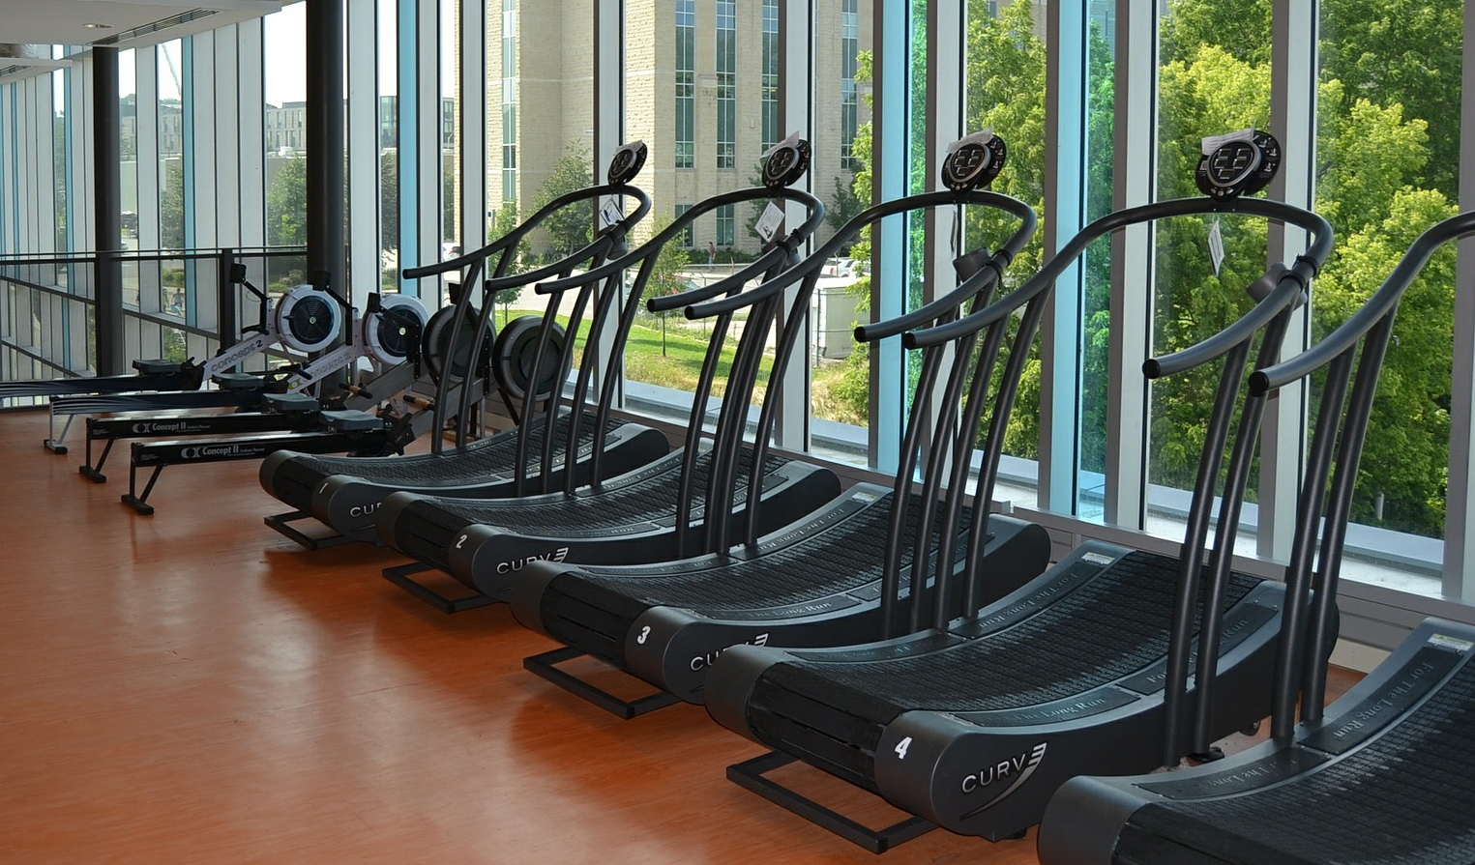
gym

Slide 15
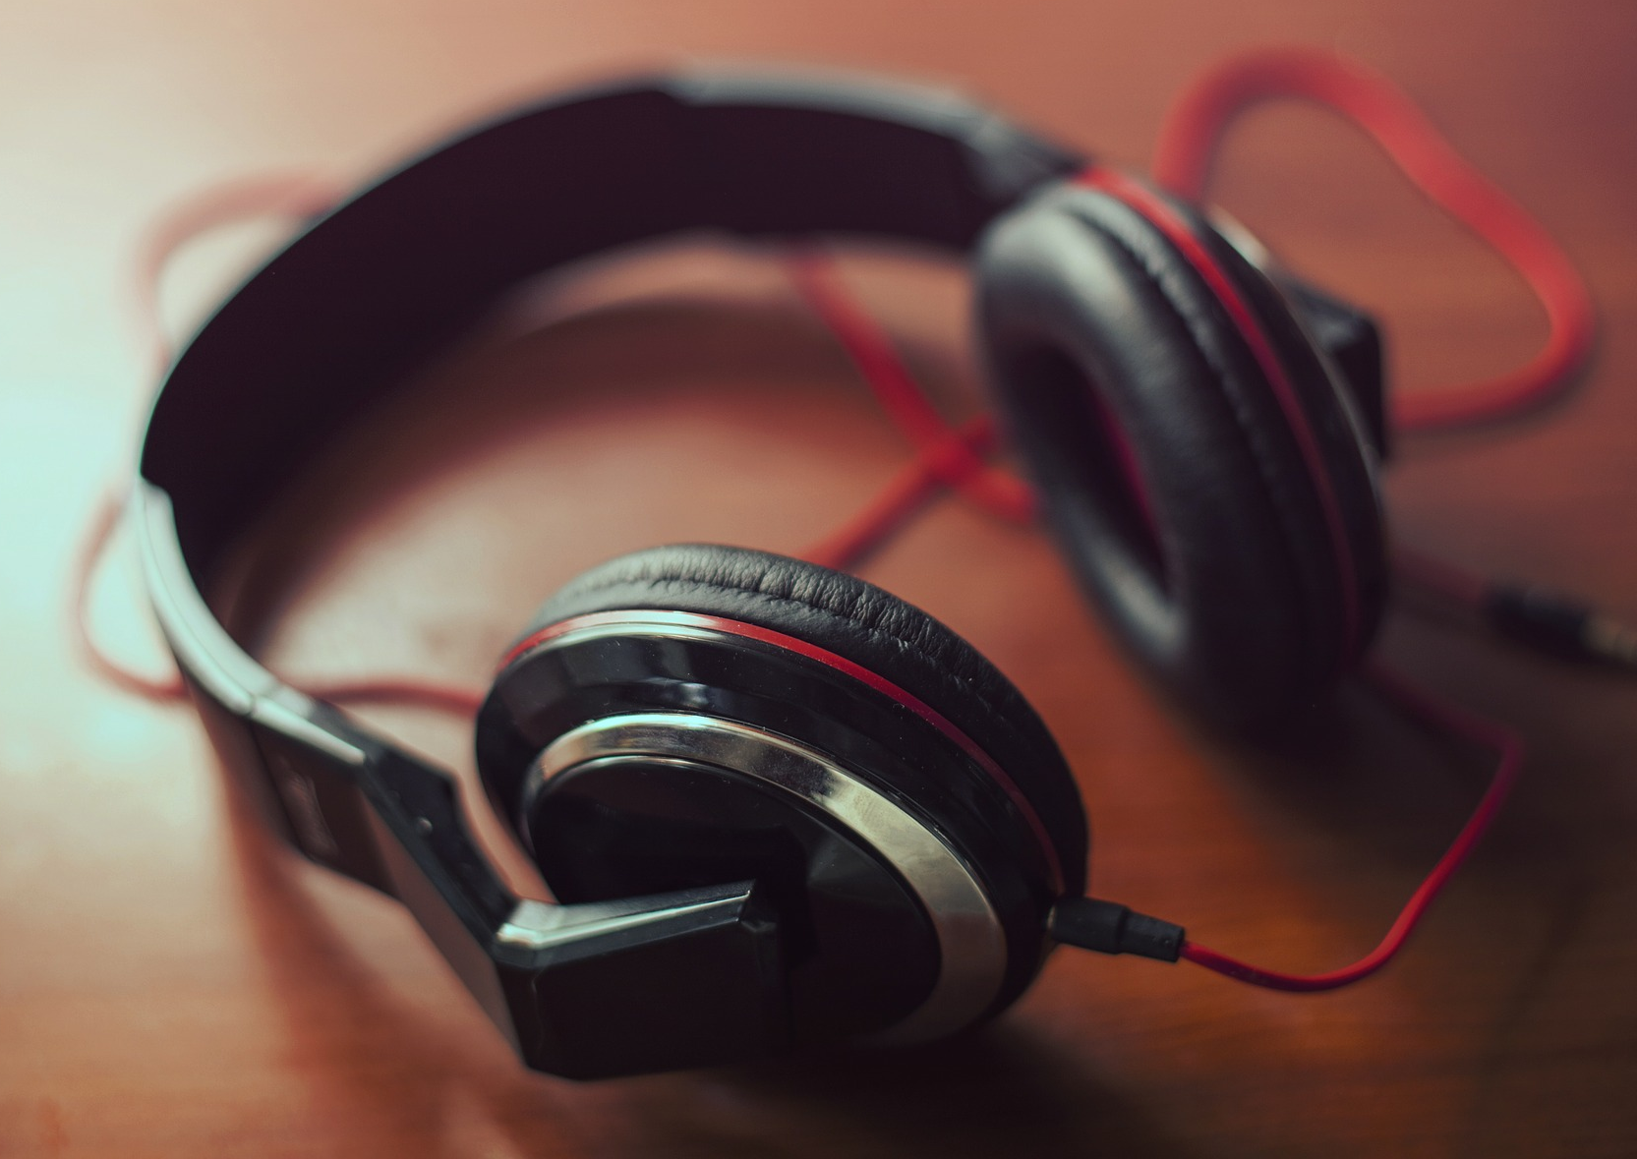
headphones

Slide 16
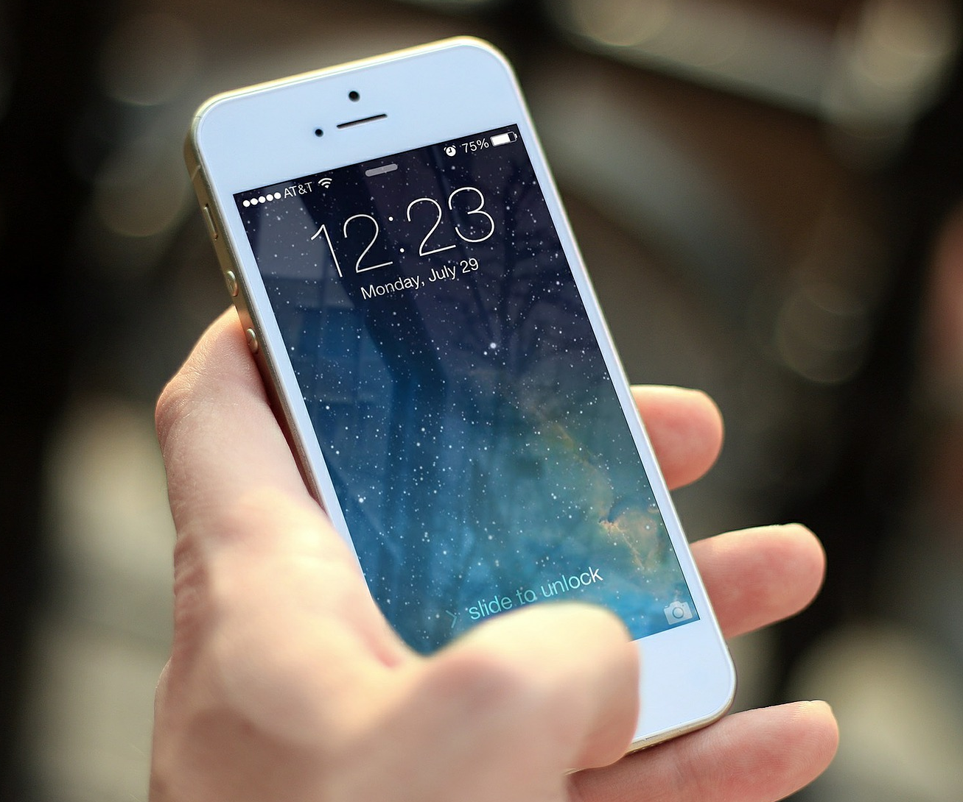
mobile phone

Slide 17
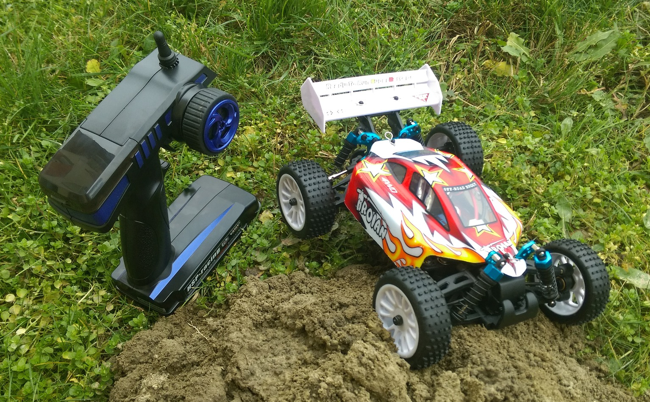
remote-controlled toy

Slide 18
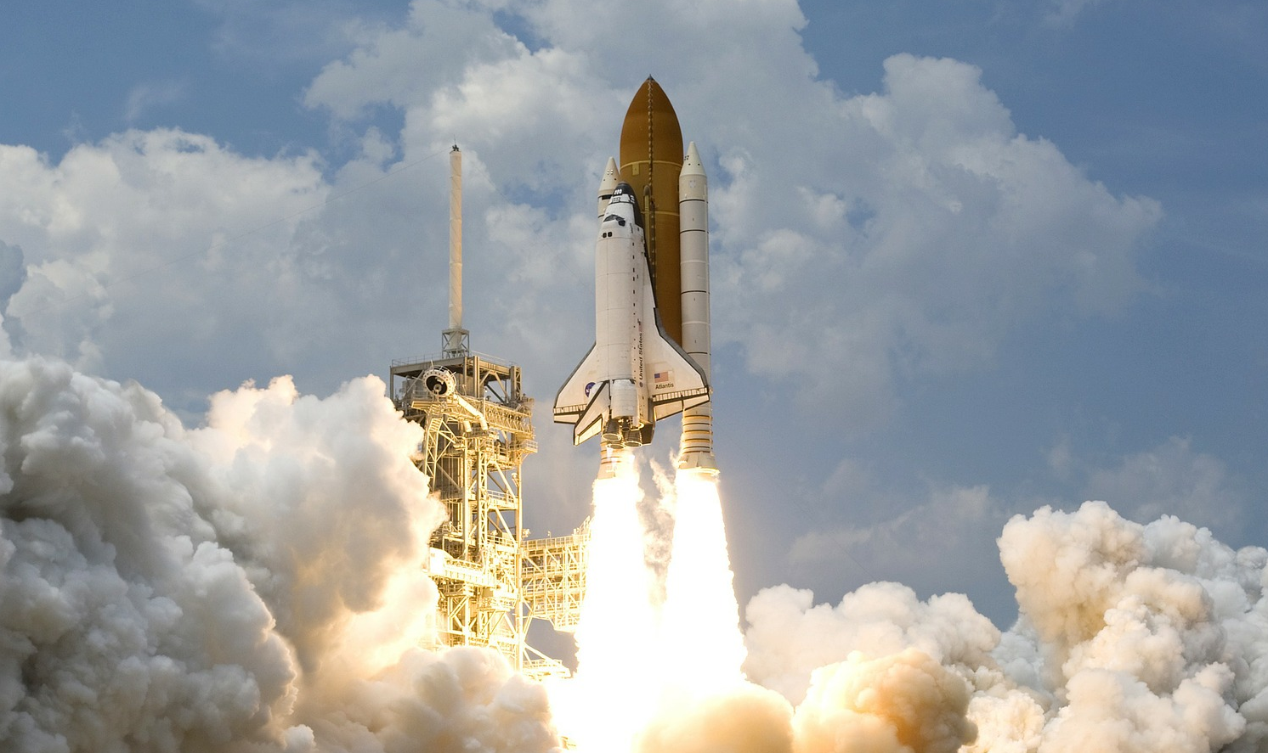
rocket

Slide 19
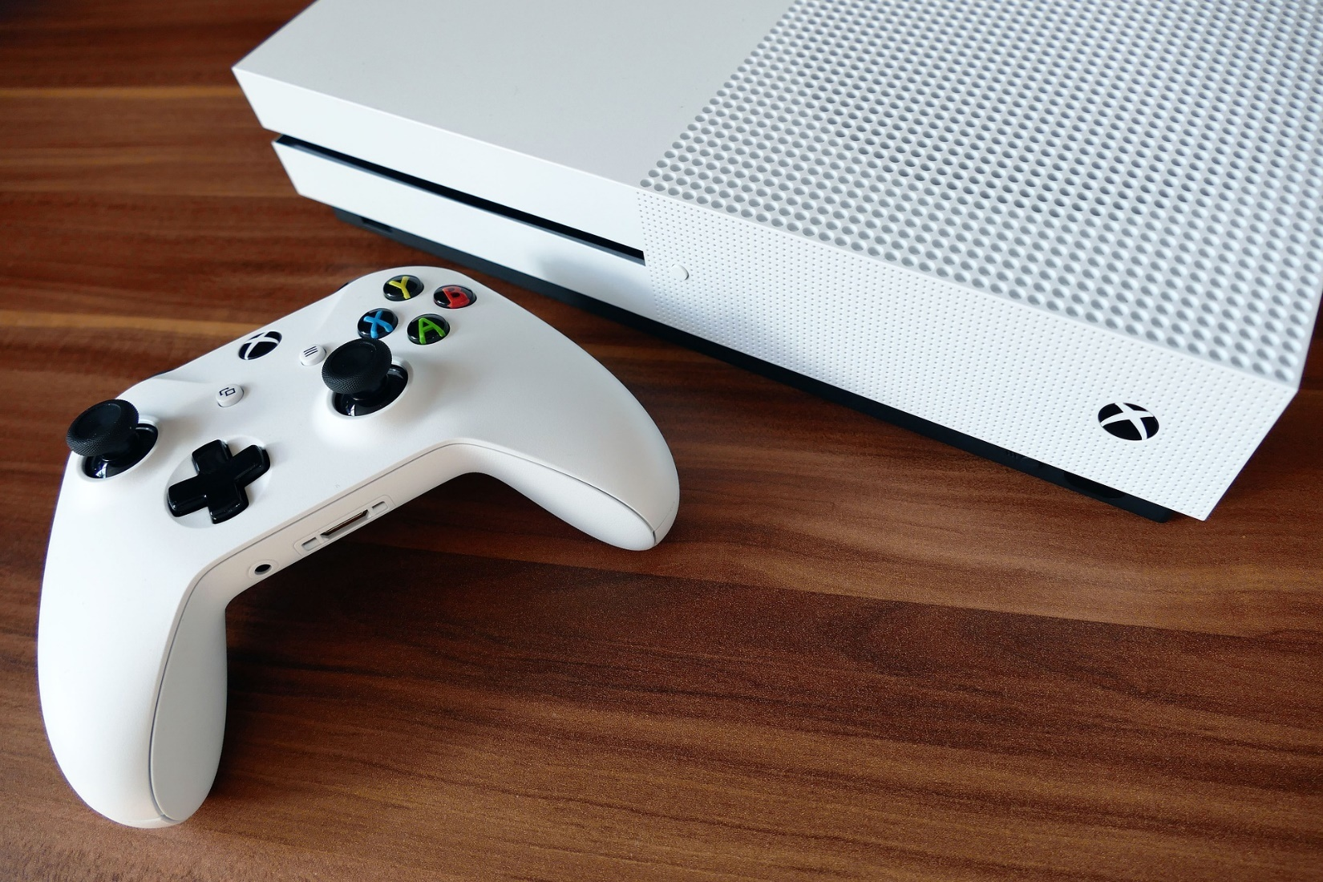
games console

Slide 20
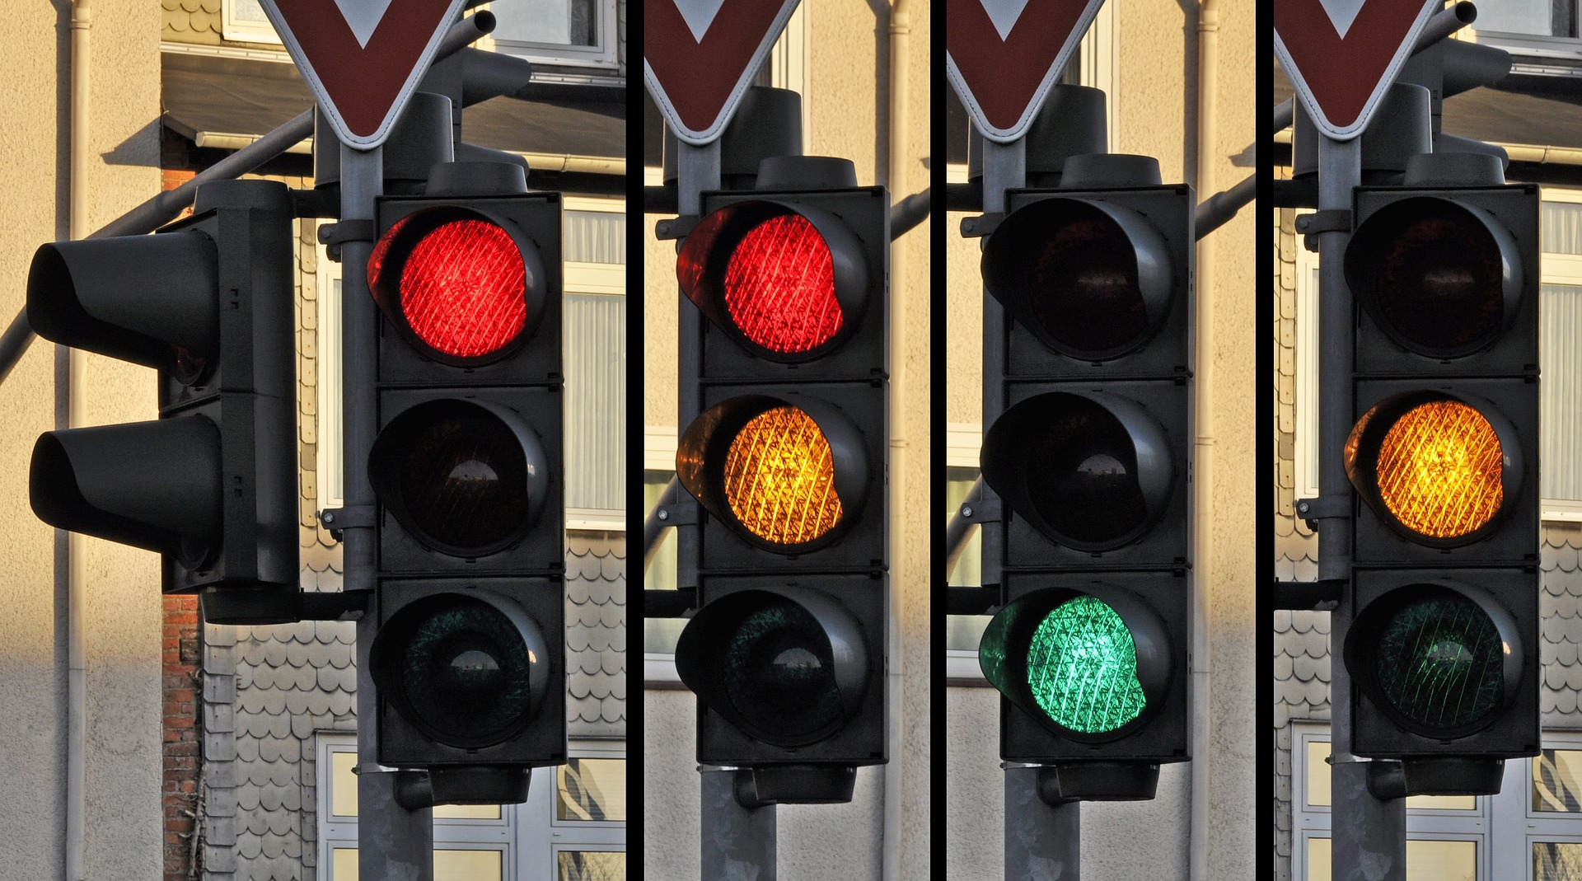
traffic lights

Slide 21
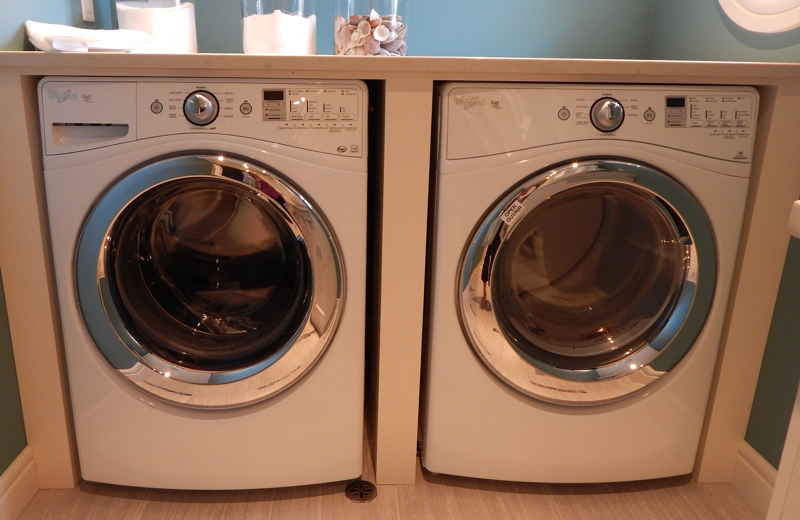
washing machine

